Slide 1
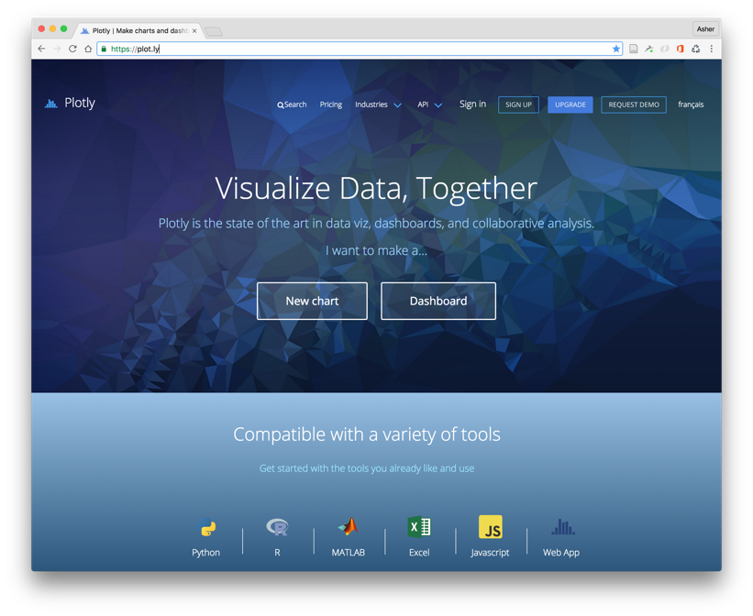
Getting Started with Plot.ly

Slide 2
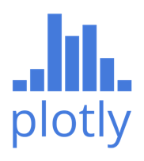
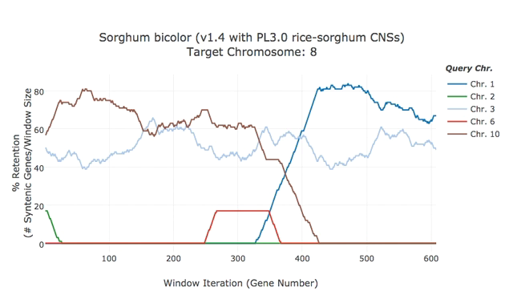


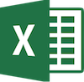

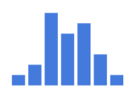

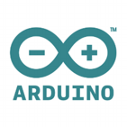
What IS Plot.ly?
Plot.ly is an open-source* data visualization tool.
… was built using Python (Django) & JavaScript.
… offers a web application for visualization & analysis.
… provides plotting APIs for many popular languages.
… plots are fully interactive, and rendered with D3.js or WebGL (for 3D).
… free, paid, and on-site offerings.
WebApp
* well, mostly open-source.

Slide 3
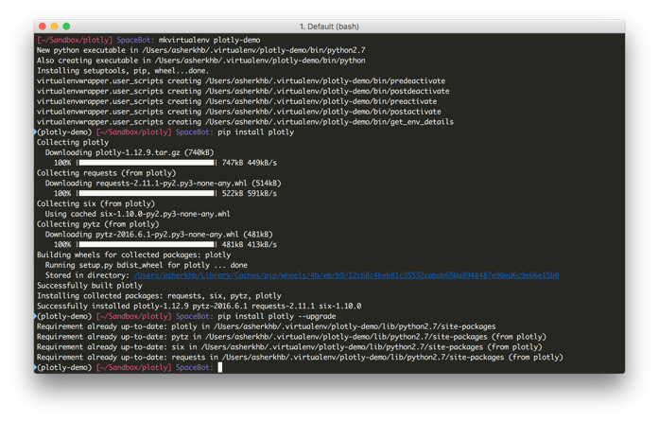
Step 1: Install Plotly Python Package
Installing is easy...just use PIP!
(sudo) pip install plotly
Updating is also easy...YAY!
(sudo) pip install plotly --upgrade
Sidenote...BOO!
Plot.ly recommends “frequently updating” the package, as they tend to release new features/bug fixes ~1x per week.
Personally, I recommend doing this in a virtual environment, just in case one of these updates would break your code.
Notes:
Sorry about the Terminal screenshot...they’re for your reference...

Slide 4
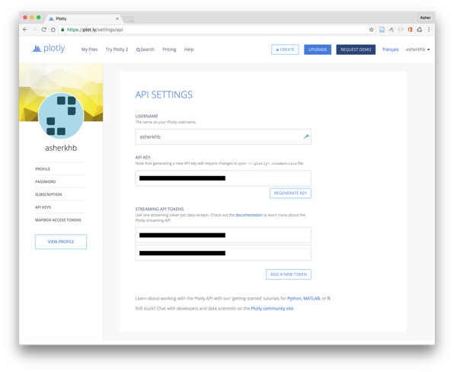
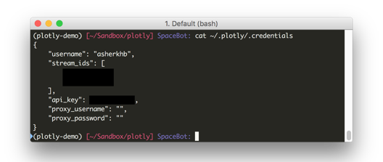
Step 2: Setup your API keys
...these are necessary for communicating with Plot.ly’s servers.
Question: What is an API?
Answer: An “Application Programming Interface”
Question: …?
Slightly More Useful Answer: A way to interact with someone else’s program, using programming languages rather than a graphical user interface
In [1] import plotly In [2] plotly.tools.set_credentials_file( \
username='YourAccount', \ api_key='YourKey')
NOTE: You only need to do this once on your computer account, even if you use different virtual environments.

Slide 5
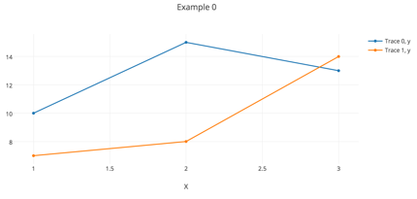
Step 3: Compose a Plot
import plotly.plotly as py
from plotly.graph_objs import *
trace0 = Scatter(x=[1, 2, 3],y=[10, 15, 13])
trace1 = Scatter(x=[1, 2, 3],y=[7, 8, 14])
my_data = Data([trace0, trace1])
my_layout = Layout( title="Example 0", xaxis=dict(title="X"))
my_figure = Figure(
data=my_data, layout=my_layout)
py.plot(my_figure, filename=’example0’)
Figure() - The Plotly “Plot” Object
Composed of two parts: ‘Data’ and ‘Layout’
Data()
Contains the information to be plotted.
Composed of ‘trace’s
Layout()
Contains information about the plot
i.e. title, labels, fonts, annotations, etc.
Figure()
Combines Data() and Layout()
https://plot.ly/~asherkhb/462/example-0/
Notes:
Don’t go over code! Just the components of a plot!

Slide 6
Step 4: Let’s Plot!!
Online
Python
iPython
Offline
Python
iPython
import plotly.plotly as py
import plotly.offline as pyo
py.plot()
pyo.plot()
py.iplot()
pyo.iplot()
Notes:
This slide is exclusively for reference

Slide 7
Online vs Offline Plotting
Online Plotting
Data is sent to Plotly’s servers, plots are generated and links are returned.
Embedded plots can be returned to iPython.
Pros
Ability to adjust look of plots using GUI.
Easy to share plots with other users.
Cons
Internet connection required, need to set up API keys.
Data is public (unless Pro account).
Offline Plotting
Data is bundled with Plotly’s library locally, made available as local .html files or divs.
Embedded plots are available when using iPython.
Pros
No internet connection or keys required.
Data remains private without paying.
Cons
Must programmatically adjust all visual parameters to achieve desired looks
Some of Plotly’s functionality not available.
Notes:
At this point, we’re going to move to an iPython notebook for demonstration.
(on Asher’s Laptop)
$ cd ~/Sandbox/plotly
$ workon plotly-demo
$ jupyter notebook

Slide 8
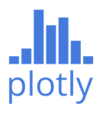
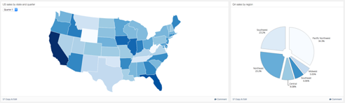
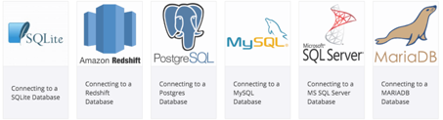


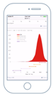
Other Features & Benefits of Plotly
Matplotlib converter!
Live & static dashboards!!
Database connections!*
Presentations?!*
Mobile Ready!
py.plot_mpl(<mpl_fig>)
https://plot.ly/matplotlib/
https://plot.ly/dashboards/
http://help.plot.ly/database-connectors/
https://formidable.com/open-source/spectacle-editor/
* untested by me personally.

Slide 9
Getting more help...
Check out the docs for basics & examples... https://plot.ly/python/
But for more info, use the docstrings... Python: help(<call>) iPython: call?
If you can’t figure it out, post to the forums… http://community.plot.ly/

